Slide 1



Cryptocurrency Price Forecasting
Group 11- Rifhad Pirani & Lilian Hall
Notes:
LILIAN:
Hi everyone, I’m Lilian and you’ll meet teammate, Rifhad in a little bit.
Welcome to our presentation about cryptocurrency price prediction using time series forecasting. Let’s begin.

Slide 2


Introduction
Cardano also known as ADA
Founded by Charles Hoskinson, who was also one of the co-founders of Ethereum.
A thousand times more energy efficient than Bitcoin
Built for the Future
Ada Lovelace
19th Century
First Computer Programmer & Mathematician
1
Notes:
We’re particularly going to analyze the Cardano cryptocurrency or digital currency. Cardano is also known as ADA after the 19th century first computer programmer & mathematician Ada Lovelace.
Cardano is founded by Charles Hoskinson, who was also one of the co-founders of Ethereum. For those who hasn’t heard of Ethereum, it’s the second most popular cryptocurrency behind bitcoin. Hoskinson took Ethereum's weaknesses made Cardano a better version of it, in fact, it’s a thousand time more energy efficient than Bitcoin. For those not familiar with bitcoin, it takes one trillion watts an hour to mine a bitcoin.
Cardano is coined as “Built for the Future” by Investor Place and is it is unique in that it is “one of the biggest blockchains to successfully use a proof-of-stake consensus mechanism, that is it replaces mining the tokens with token ownership.

Slide 3

Hypothesis
Null hypothesis:
To predict the future Low Price of Cardano using an ARMA model.
Alternative hypothesis:
The Low Price of Cardano cannot be predicted using the ARMA model.
2

Slide 4


Motivation
Cardano holders “have the right to vote on any proposed changes to the software” ^{(3).}
Analyze the times series using different models discussed in chapters 6,7,8,9,10 and 11 in our textbook
to find the best model with least error
3
Notes:
Motivations for choosing this dataset:
1st: it’s a personal project, I’ve personally invested in Cardano and would like to predict future low price of it.
2nd: uses an ADA token that is configured that certifies its owners to be involved in the operation of the network. As a result of this, Cardano holders have the right to vote on any proposed changes to the software.
We aim to achieve the following objectives in our project: analyze the time series using different models in chapters 6-11 and find the best model with the least error.
I’ll pass it on to Rifhad and he’ll talk about our dataset.

Slide 5


Dataset
Low price of Cardano
January 1, 2021 – June 24, 2021
www.coinmarketcap.com
4
Notes:
RIFHAD:
Our dataset started with four years of worth daily prices totaling about 1,300 but with the advice of Dr. Fathi, we cut it down to Jan 2021 - June 24, 2021 data, however, for the decomposition model, we used all the available data from 2017 to 2021 but broken in months. The historical data is available for download from coinmarketcap.com.

Slide 6

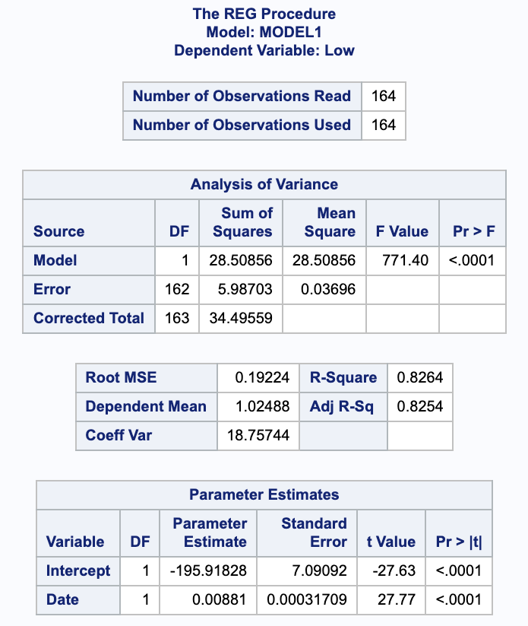
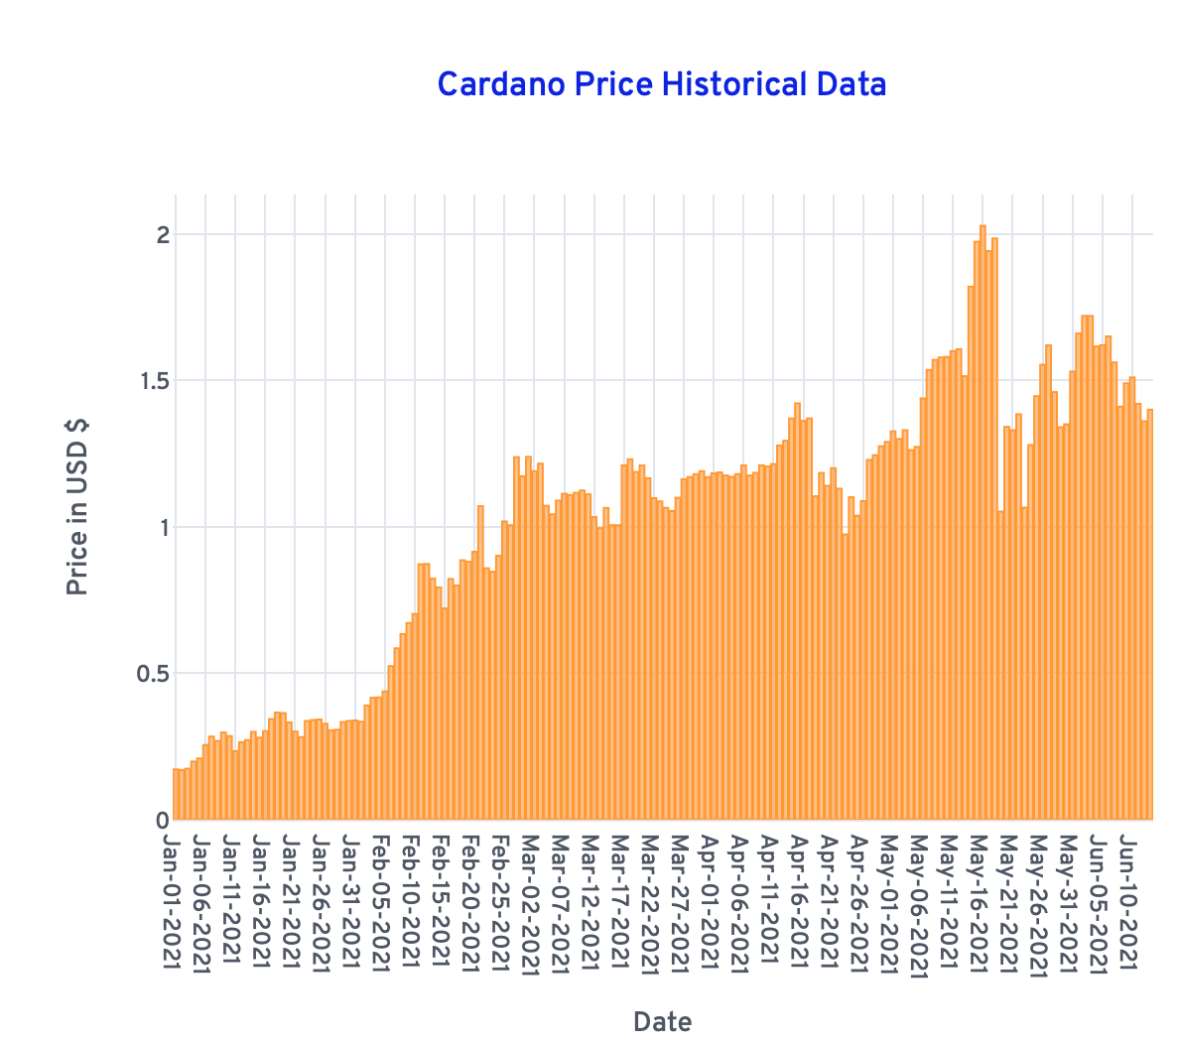
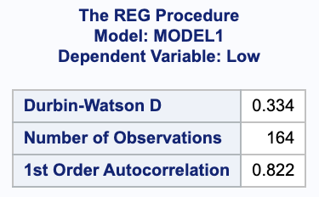
Time Series Regression
β₀
β₁
5
Notes:
In plotting our data to time series regression as seen here it shows no cycle nor seasonality but shows an increasingly positive trend. The SAS output here shows the time series model is significant because the P-value is less than alpha, Beta zero, and Beta one’s P-value is less than alpha, so they are significant for the model. In fig.3 (b), we use the Durbin Watson Statistic to detect the first-order autocorrelation of the model. It shows d is less than DL, alpha, so we reject the null hypothesis and so the errors are positively autocorrelated, thus making this model inadequate.

Slide 7
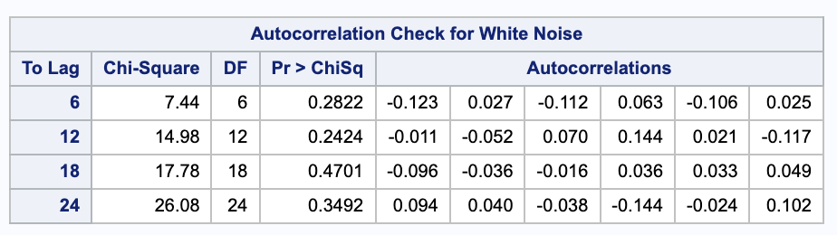
Logarithmic Transformation
> α
Model 1 z_{t} = δ + a_{t}
5
Notes:
After performing a logarithmic transformation at order 1, the model z_{t} = δ(delta) + a_{t} is an adequate model because the values of Q with the Ljung-Box test are greater than alpha.

Slide 8
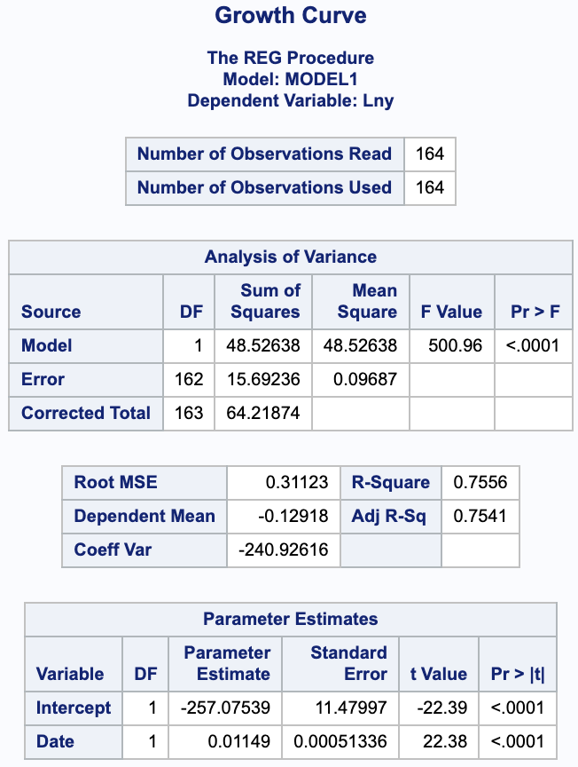
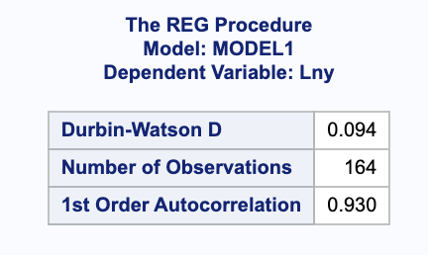
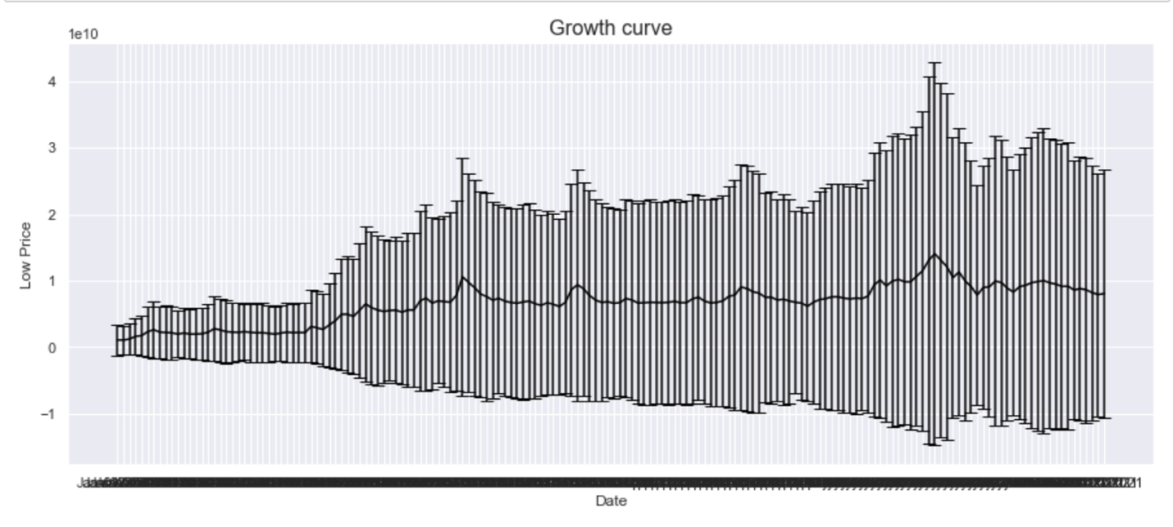
Growth Curve
5
Notes:
In point estimation prediction, a model must be transformed to have linear parameters and the growth curve model does this by taking the logarithms on both sides. The Durbin-Watson statistic for this model is .094 and shows evidence that the error terms for this model display first-order autocorrelation. SAS output shows the p-values are less than alpha and are therefore significant.
I’ll pass it on to Lilian to talk about Decomposition.

Slide 9

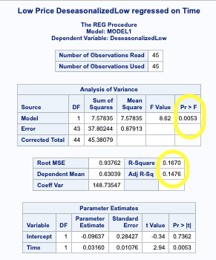
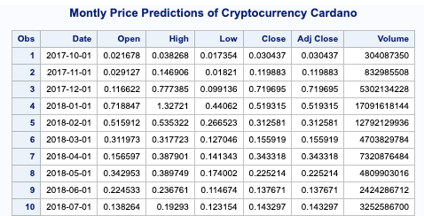
Decomposition
Monthly dataset
7
Notes:
LILIAN: To forecast time series that exhibit trend and seasonal effects, decomposition models such as multiplicative and additive decomposition models can be modeled adequately using moving averages and centered moving averages to eliminate such seasonal variations and irregular fluctuations. Multiplicative is useful when seasonal variation increases over time and additive are useful when the seasonal variation is relatively constant over time. Before decomposing the time series, we used the monthly dataset to apply it to the multiplicative model. The SAS output can be seen in fig. 5. and with a p-value, a little over alpha, and a very low R² signifies that this model is not adequate.

Slide 10

Exponential Smoothing
Table 1 - Fit
Table 2 - Performance
 | R² | AIC | SBC | MSE
Simple | 94.06% | -675.4494 | -672.4125 | .0123
Linear Holt’s | 94.15% | -675.1774 | -669.1041 | .0122
Winter’s | 93.71% | -662.15658 | -653.04572 | .0131
 | R² | AIC | SBC | MSE
Simple | -466.23% | -28.9151 | -28.9151 | .0555
Linear Holt’s | -788.43% | -24.4105 | -24.4105 | .0871
Winter’s | -722.08% | -25.1867 | -25.1867 | .0806
9
Notes:
LILIAN:
Exponential Smoothing is useful when a time series changes over time, has trend and seasonal factors because it gives higher weight on the most recent observed values. We trained our data using three models: Simple Linear, Winter’s, and Holt Exponential Smoothing. Table 1 shows the comparison of how the three models fit our dataset using R squared, AIC, SBC & MSE . Linear Holt’s Exponential Smoothing model fared better than the other two models when fitting the model to the time series because it has the highest R² and least errors. This model is useful for a series with trend but no seasonal variation. Table 2 shows the performance values, as you can see the R2 were significantly less but the model with the least error is the Simple exponential smoothing model.

Slide 11
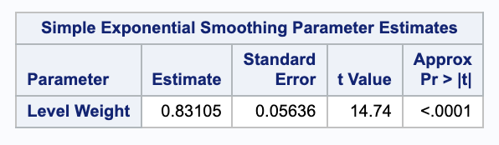
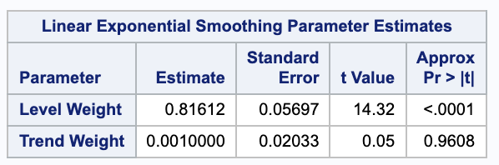
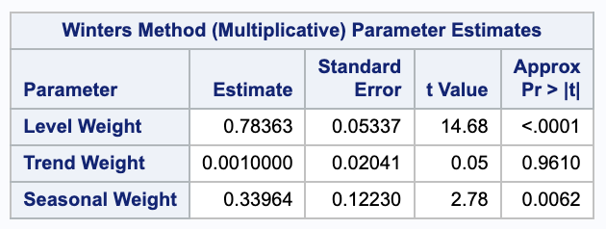
Exponential Smoothing
9
Notes:
The SAS output shown are the p-values and the level weight for all three models as significant.
I’ll let Rifhad explain the next Model.

Slide 12

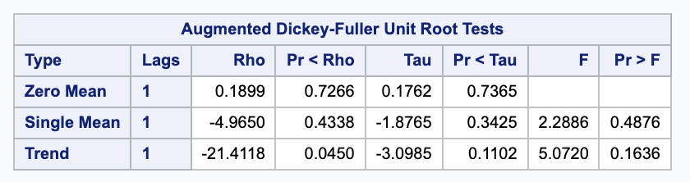
ARIMA Model
> α
11
Notes:
RIFHAD: In time series analysis, an autoregressive integrated moving average or ARIMA model requires the dataset to be stationary. In pre-processing the dataset, we used two methods to test stationarity. First, we looked at Augmented Dickey-Fuller Test p-values and SAC. Here, the ADF test shows the p-values as greater than alpha , and thus proving this model as non-stationary

Slide 13
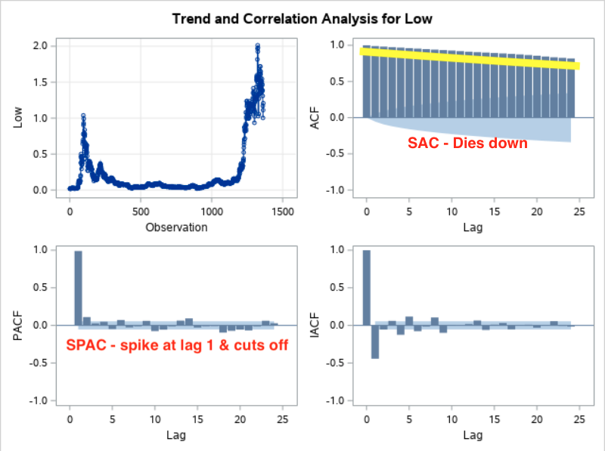
ARIMA MODEL
11
Notes:
This show the SAC and SPAC. SAC is slowly dying down and SPAC after a spike at lag one, cuts off. As a result, data is non-stationary.

Slide 14
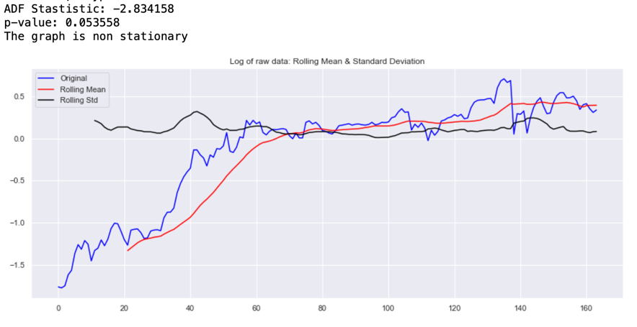
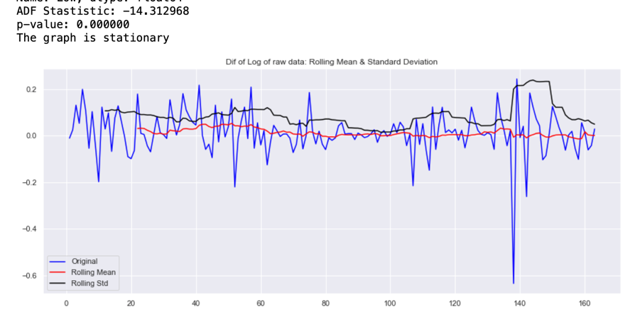
ARIMA MODEL
Before Differencing
After Differencing
11
Notes:
To attain stationary, in the time series, first-order differencing at lag one was applied, and you can see the before and after plot here. Before differencing, the p-value was more than alpha and after differencing we can see p-value is less than alpha and therefore, making the time series stationary.

Slide 15

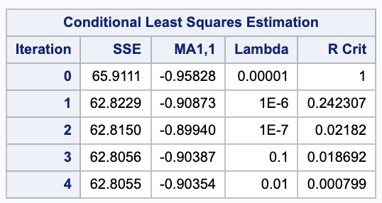
Invertibility, Ljung-Box, Autocorrelation & t-values
θ_{1 hat} = -.95828 after 4 iterations, and since |θ₁ | < 1 this model satisfies the invertibility condition.
12
Notes:
Box-Jenkins models require forecasting the time series to be stationary and invertible. The moving average model point estimate results are shown here with
(theta)θ_{1 hat} = -.95828 after 4 iterations, and since (absolute value of theta one is less than one) |θ₁ | < 1 this model satisfies the invertibility condition.

Slide 16
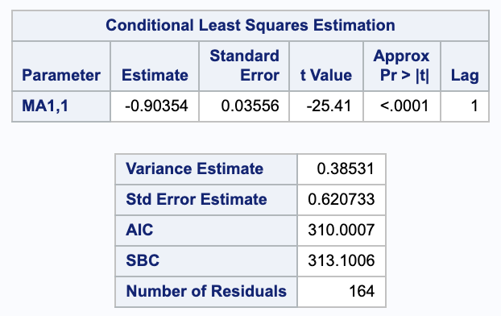
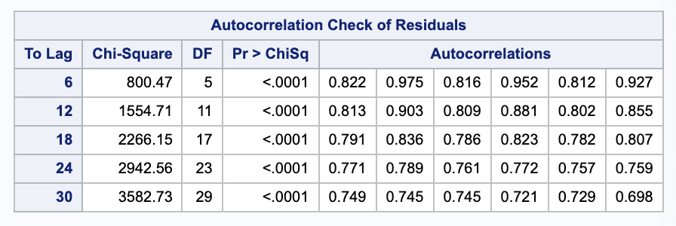
Invertibility, Ljung-Box, Autocorrelation & t-values
12
Notes:
Since the highest absolute estimated correlation between the point estimates found in the correlation matrix is > .9, we conclude that the point estimates in this model are highly correlated.
The absolute t-value = 25.41 which is greater than 2 and p-value is less than .05. Thus, it is reasonable to retain this parameter in the model.
The Ljung-Box statistic tests the adequacy of the overall model as seen here which shows the values as less than .05 alpha. Thus, this model is inadequate.

Slide 17

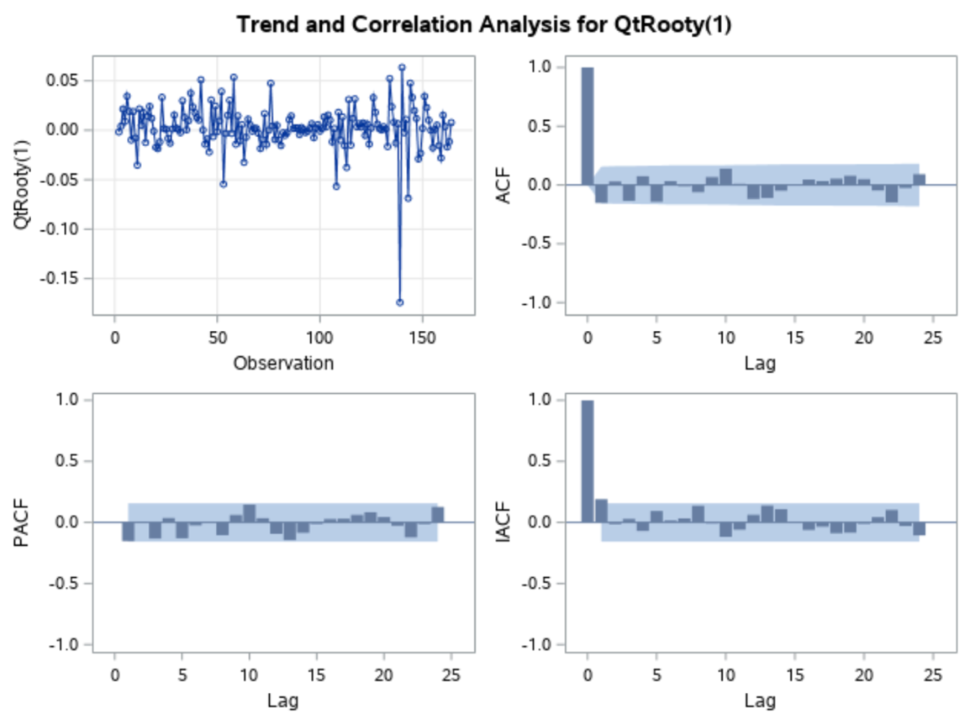
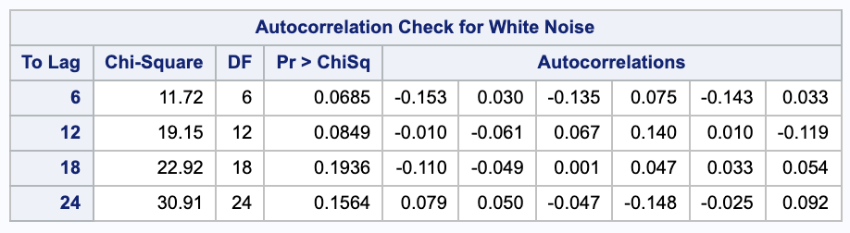
Seasonal
Box-Jenkins
No Spike
No Spike
14
Notes:
The Seasonal Box-Jenkins model is used to improve the error structure and transform the time series regression into a stationary time series by using pre-differencing transformation. After performing the seasonal quartic root transformations to our dataset, the Q values in the Ljung-Box statistic show values greater than alpha and shows there no spike in the SAC and SPAC, so we can therefore conclude that this model is adequate.
I’ll pass it on to Lilian to discuss our conclusion.

Slide 18
Conclusion
MODEL | AIC | SBC | STD ERROR | R²
Model 1 z_{t} = δ + a_{t} | -301.629 | -298.536 | .095633
Model 2 ARMA(1) | -753.308 | -750.214 | .023927
Model 3 Lny = log(y) |  |  | .31123 | 75.56%
Model 4 Y_{t} = β₀+ β₁t + ε_{t} |  |  | .19224 | 82.64%
Model 5 Y_{t} = β₀+ β₁t + β₁t² ε_{t} |  |  | .19224 | 82.64%
2
Notes:
LILIAN: After building different models found in chapters 6-11, we found the following models to be adequate and they are represented in the table here. Using logarithmic transformation in Model 1 and quartic root transformations in Model 2 showed Q values that are greater than alpha making the models adequate. On the other hand, comparing Log, Linear, and Quadratic in Models 3-5, showed the following results. In comparing all 5 Models based on standard error, the model with the least error is Model 2 ARMA on the first order.

Slide 19
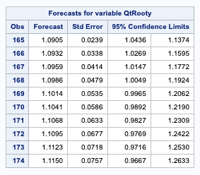
Forecasted Low Price for Cardano
June 25, 2021
June 26, 2021
June 27, 2021
June 28, 2021
June 29, 202
June 30, 2021
July 1, 2021
July 2, 2021
July 3, 2021
July 4, 2021
2
Notes:
Here are the forecasted future Low Price of Cardano with 95% confidence limits and standard error.

Slide 20
Thank you.
Notes:
This concludes our presentation and thank you!

